Slide 1


Presentation Title
Subtitle
Since 2002 on the market
22 years in Cybersecurity
350+ employees

Slide 2

Agenda
Section 1
Section 2
Section 3
Since 2002 on the market
21 years in Cybersecurity
400+ employees

Slide 3
Slide example with table
Supporting text
Model and Criteria
Fixed price
Time and materials
Dedicated team*
Budget
Fixed
Flexible
Predicted
Deadlines
Predefined
Flexible
Long-term defined
Scope of work
Predefined
Dynamic
Long-term defined
Project size
Small
Small / Medium
Medium / Large
Average project duration
6 months or less
6 to 12 months
1+ years
*80% of Apriorit clients leverage
the Dedicated Team cooperation model.
Since 2002 on the market
21 years in Cybersecurity
400+ employees

Slide 4
Slide example
Endpoint and Network
Backup, Restore, Datahandling
Security Stealth Technologies
All Level System Monitorings
Device Management and Blocking
BootLoader Level Technologies
Screen Monitoring
Work with locked files
Data Parsers
System Snapshots
Virtualization and Remote Access
Mobile Platforms
Redirection Technologies
Remote Devices
Object Virtualization
Hypervisor Level Access
Successful combination of Reverse Engineering, Architecture & Format Research, and experienced development allowed us to develop
a number of solutions for various platforms and mobile OS.
Since 2002 on the market
21 years in Cybersecurity
350+ employees

Slide 5




Slide example
Supporting text
We set the bar for cybersecurity standards that others struggle to meet.
Turn top-level data protection and secure operations into your greatest business advantage. Leverage Apriorit’s niche skills and 21+ years of cybersecurity expertise to make your software:
ХХХХ
ХХХХ
Competitive
Reliable
ХХХХ
ХХХХ
Performant
Secure
Since 2002 on the market
21 years in Cybersecurity
400+ employees

Slide 6


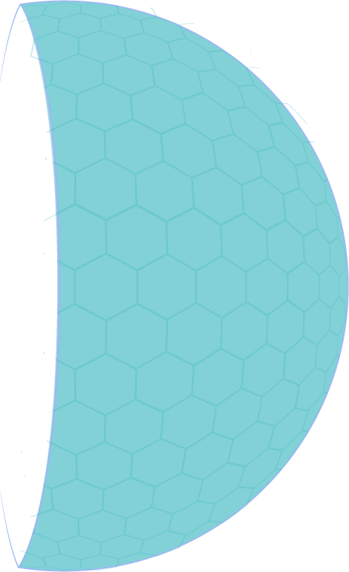
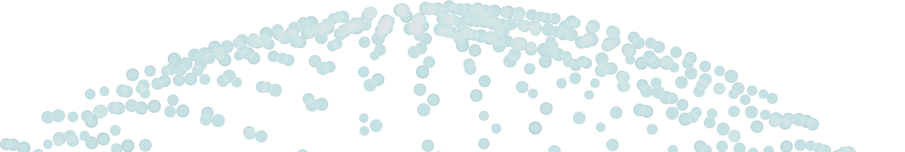
Slide example
MIDDLE LAYER
Administrative panel & settings, databases, client-server architecture, remote access
SYSTEM LAYER
Inter process communication, processes control and monitoring, process interceptions, device management, bootloader, network filtering
WEB LAYER
SaaS, cloud development
UNIFYING LAYER
Development, reversing, QA, PM, DevOps
EMBEDDED LAYER
Since 2002 on the market
21 years in Cybersecurity
350+ employees

Slide 7
Slide example with steps
NDA signing
(if needed)
Discovery stage with estimation
Approvals
MSA signing
Statement of work signing
Ready to discuss you project?
Contact us
Since 2002 on the market
21 years in Cybersecurity
350+ employees

Slide 8





Slide example
We can help you develop:
Boost the intelligence of your business with Apriorit’s niche expertise in machine learning, deep learning, and artificial intelligence.
Our developers, data engineers, and QA specialists will fuel your AI projects requiring niche expertise in:
AI chatbots and virtual assistants
Language translation tools
Speech recognition systems
Image recognition systems
Sentiment analysis systems
Facial recognition systems
Augmented reality applications
Data analytics systems
Recommendation systems
Content creation platforms
ХХХХ
ХХХХ
Computer vision
Natural language processing
ХХХХ
ХХХХ
Data analytics and visualization
Anomaly detection
Since 2002 on the market
21 years in Cybersecurity
400+ employees

Slide 9

Slide example
Locations
Our typical responsibility schemes:
USA, Canada, UK, France, South Korea, India, UAE, Germany, Spain, Sweden
Full-Cycle Product Development Development of Product Components/Modules Team Augmentation
Reference customers:
Dell Inc. (US, 100’000 employees, enterprise software) – Registered Vendor status since 2013 Logmein (US, 2500+ employees public company, SaaS and on-premise) Logentries (now Rapid7) (US, 30+ employees startup, SaaS) Airtame (Sweden, hardware startup)
Sizes
From 3 people startups
to 100’000 people enterprises
Since 2002 on the market
21 years in Cybersecurity
400+ employees

Slide 10
Slide example
Used technologies
Subtitle
Ontology blockchain network
GoLang
React.JS
Node.JS
Python
Amazon Web Services
Our client is a financial services provider wanted to start a blockchain-powered remittance service that could support a high volume of transactions. They had already a token based on Ethereum, but it had several issues. To meet our client’s needs, we designed a smart economy and developed a new Ontology-based network, web wallet, decentralized application (DApp), and Android application.
Challenges
Result
Lack of flexibility
The smart contract was difficult to update once it was deployed to the Ethereum network
Fast and cheap transactions
Created a solution with a maximum capacity of around 3,000 transactions per second. Transactions cost - less than $0.0001 each.
Slow operations
Confirming transactions could take up to several minutes.
Complex solution
The complex remittance blockchain solution that corresponded with initial vision of the client
High transaction price
The cost could get as high as $0.10 if the network was particularly busy.
Since 2002 on the market
21 years in Cybersecurity
400+ employees

Slide 11

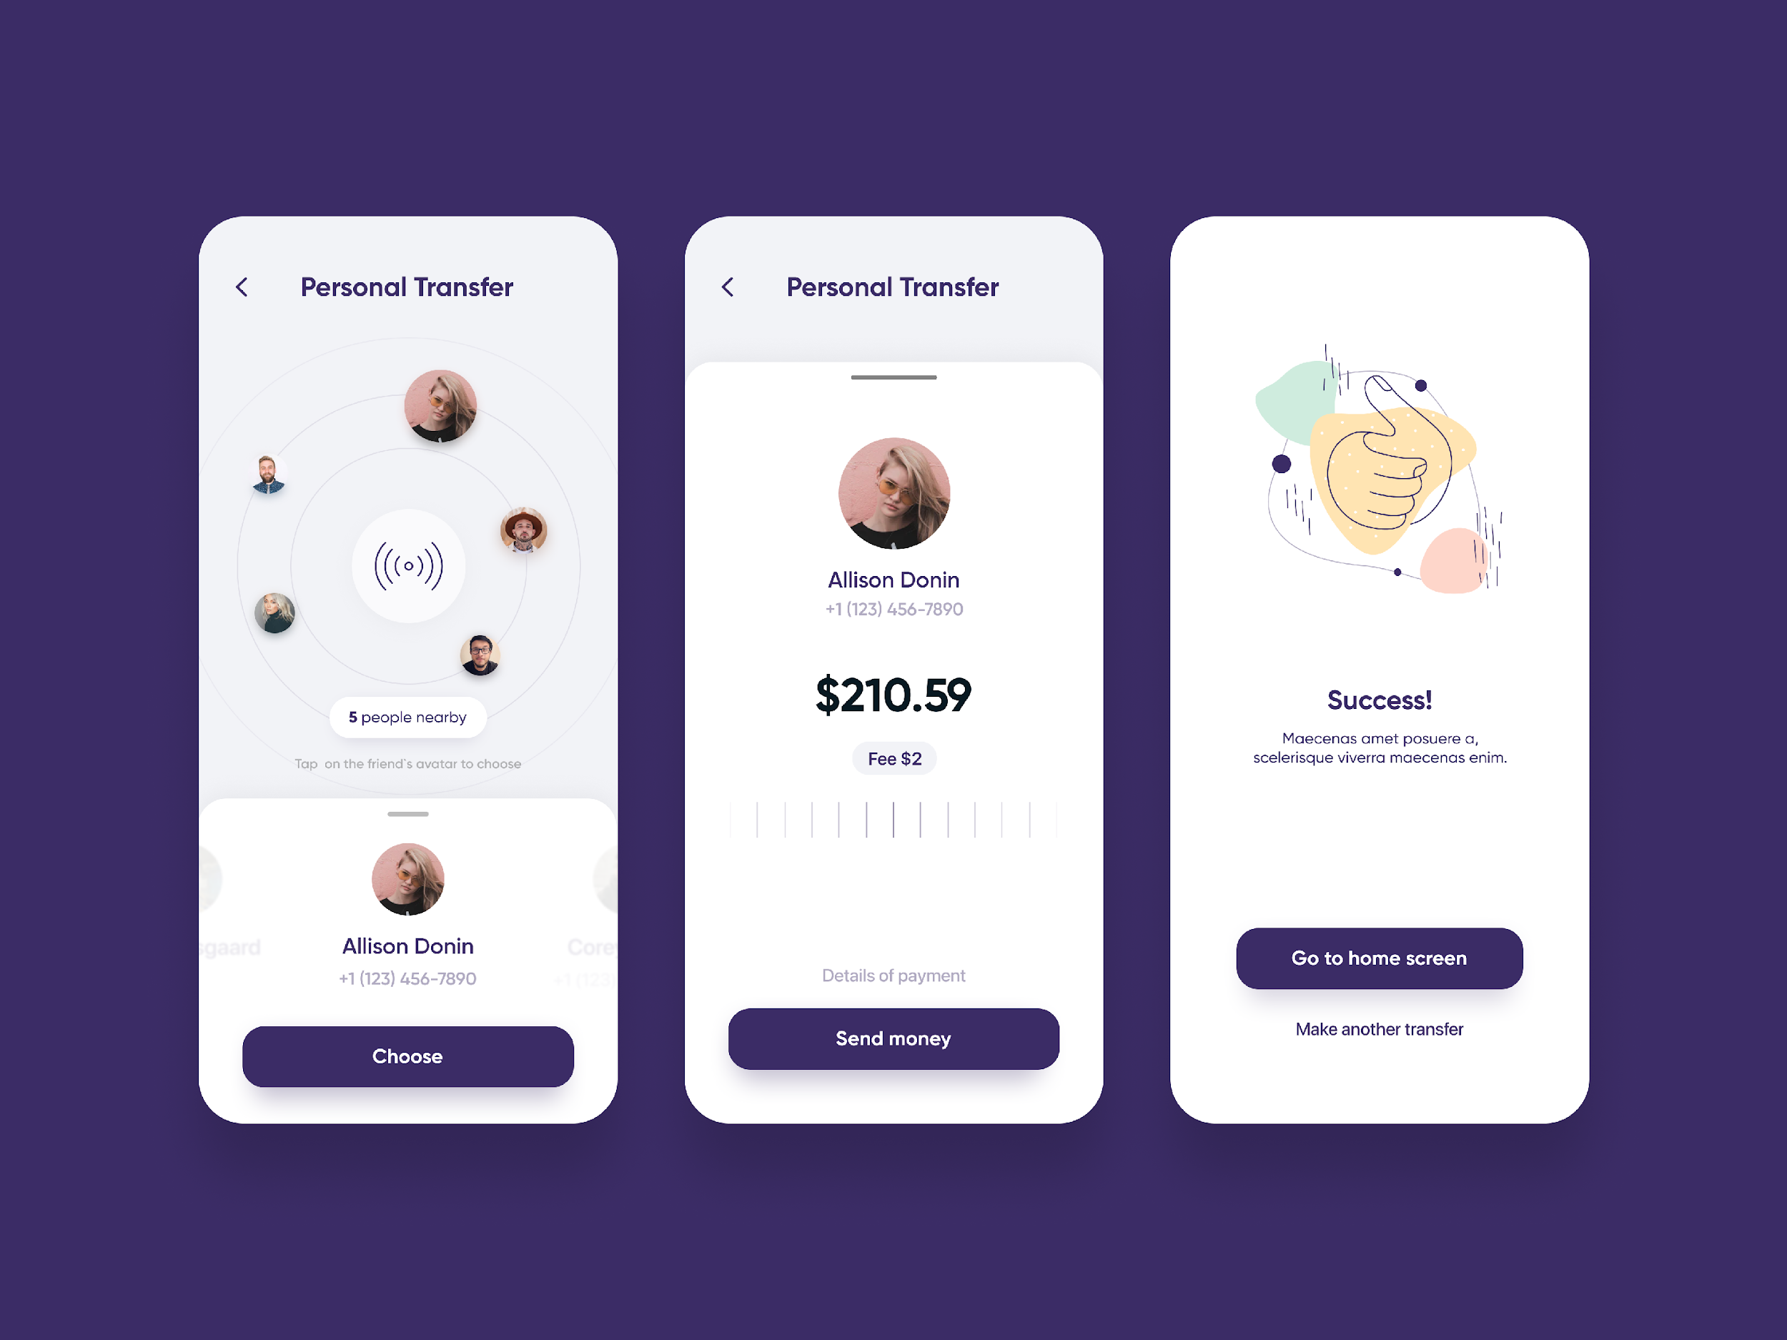
Slide example
Solutions we utilize have been meticulously designed to propel your FinTech project to new heights. From secure payment processing to data analytics and beyond, we offer a comprehensive suite of tools that drive efficiency and innovation. Whether you're a startup aiming to disrupt the industry or an established player seeking to optimize your operations, our digital solutions are your key to success. Join us on a journey towards financial innovation and excellence – the future of FinTech starts here.
Multi-factor authentication
Peer-to-peer transactions
3ds LookUp integration
OTP verification
Face ID and Touch ID
e-wallet (any credit cards support)
Design-templates
Push notifications
API development
AI recognizing system based on ML Kit: doc types recognizing and verification, credit cards recognizing
Deep links for fast direct screen transfer
UI design templates (different colors)
Back-end development (C#, PHP, NodeJS, Go, Python)
Since 2002 on the market
21 years in Cybersecurity
400+ employees

Slide 12
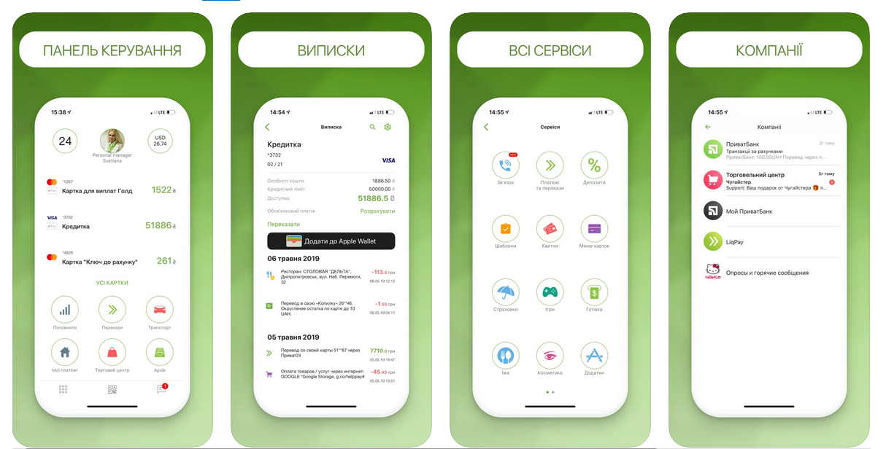

Slide example
Subtitle
We developed the first version of Privat24 mobile banking app.
Privat bank mobile app has more than 10 million users.
Phone registration
Credit cards management
Information on transactions
Payments: peer-to-peer, online tickets (railway, flight), bills, fees, fines, online games, parking, etc.
Loans
Deposits
Push notifications
Since 2002 on the market
21 years in Cybersecurity
400+ employees

Slide 13


Any questions?
Can we discuss next steps?
Since 2002 on the market
21 years in Cybersecurity
400+ employees

Slide 14






Thank you!
If you have any questions , please contact us at
info@apriorit.com
www.apriorit.com
Follow us on social media:
www.linkedin.com/company/apriorit
www.twitter.com/Apriorit
www.softwareengineeringblog.quora.com
www.facebook.com/apriorit
Since 2002 on the market
21 years in Cybersecurity
350+ employees

